Slide 1
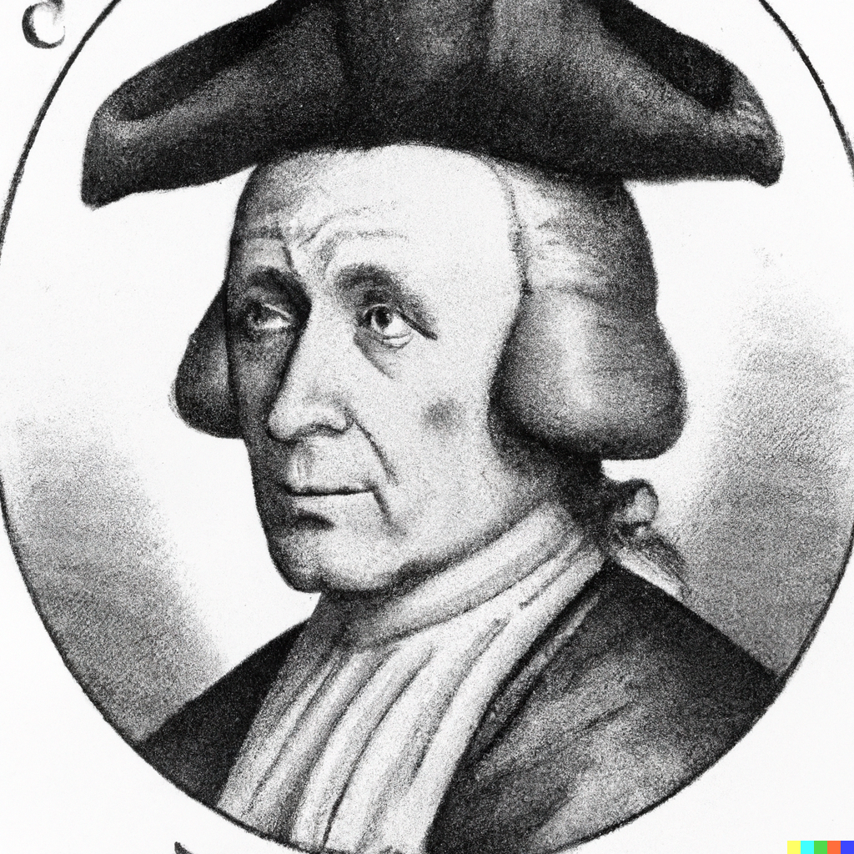
Probability and Naïve Bayes
Applied Machine Learning Derek Hoiem
Dall-E: portrait of Thomas Bayes with a Dunce Cap on his head

Slide 2
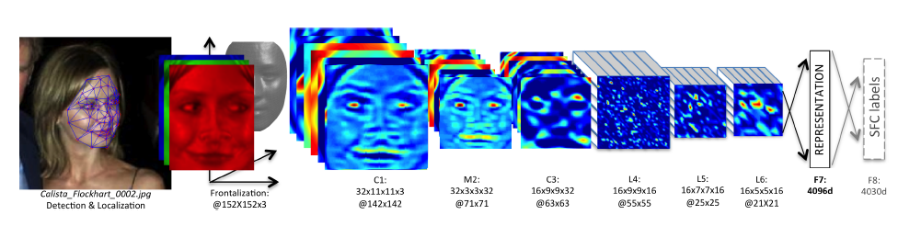
KNN Usage Example: Deep Face
CVPR 2014
Detect facial features
Align faces to be frontal
Extract features using deep network while training classifier to label image into person (dataset based on employee faces)
In testing, extract features from deep network and use nearest neighbor classifier to assign identity
Performs similarly to humans in the LFW dataset (labeled faces in the wild)
Can be used to organize photo albums, identifying celebrities, or alert user when someone posts an image of them
This algorithm is used by Facebook (though with expanded training data)
Think about potential unintended consequences, e.g. due to how features are trained or its application

Slide 3
KNN Summary
Key Assumptions
Samples with similar input features will have similar output predictions
Depending on distance measure, may assume all dimensions are equally important
Model Parameters
Features and predictions of the training set
Designs
K (number of nearest neighbors to use for prediction)
How to combine multiple predictions if K > 1
Feature design (selection, transformations)
Distance function (e.g. L2, L1, Mahalanobis)
When to Use
Few examples per class, many classes
Features are all roughly equally important
Training data available for prediction changes frequently
Can be applied to classification or regression, with discrete or continuous features
Most powerful when combined with feature learning
When Not to Use
Many examples are available per class (feature learning with linear classifier may be better)
Limited storage (cannot store many training examples)
Limited computation (linear model may be faster to evaluate)

Slide 4
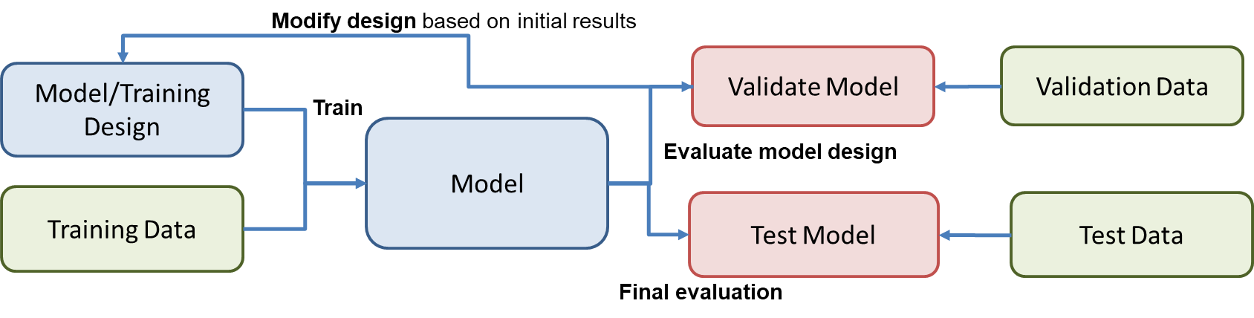
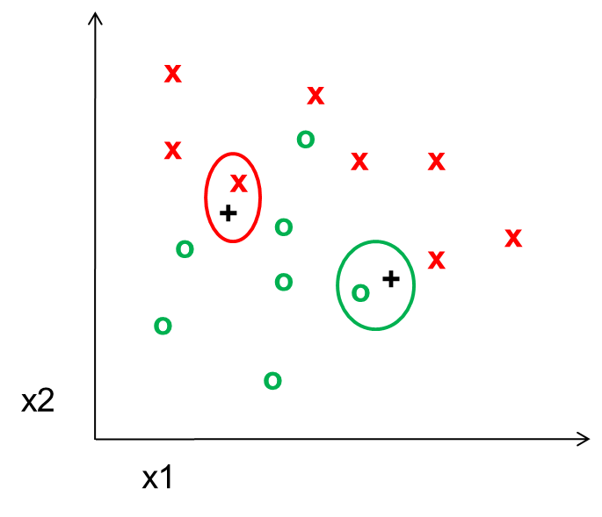
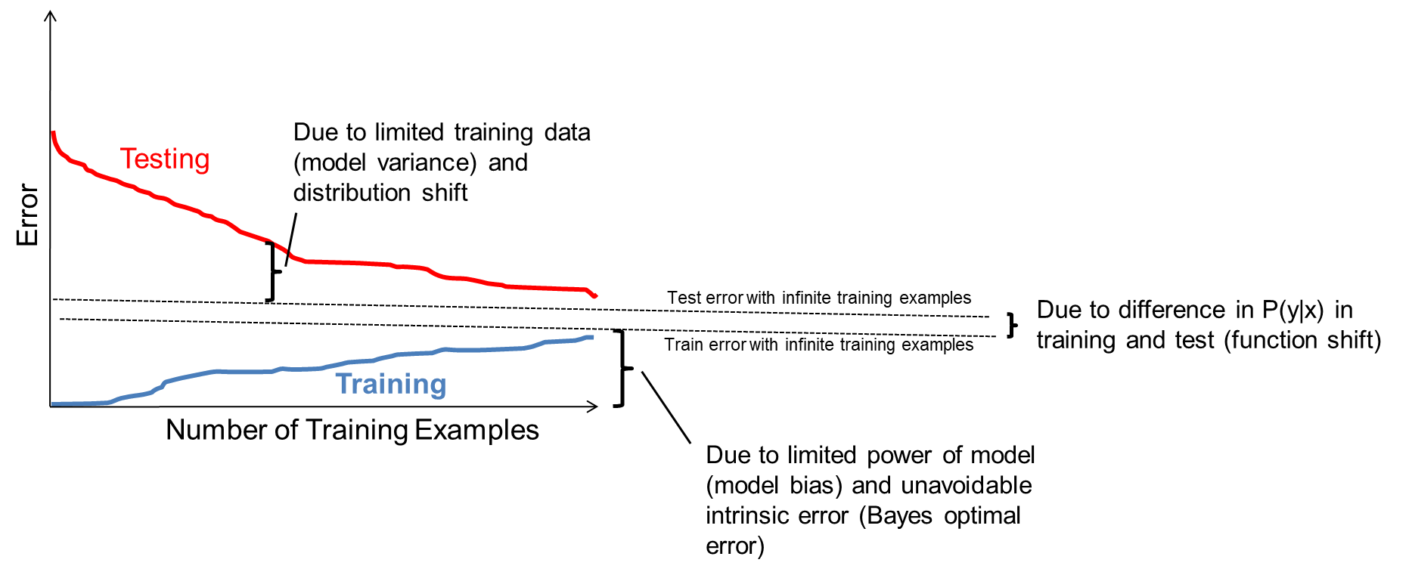
Things to remember (from last class)
Supervised machine learning involves:
Fitting parameters to a model using training data
Refining the model based on validation performance
Evaluating the final model on a held out test set
KNN is a simple but effective classifier/regressor that predicts the label of the most similar training example(s)
With more samples, fitting the training data becomes harder, but test error is expected to decrease
Test errors have many sources
intrinsic to problem
model bias / limited power
model variance / limited training data
differences in training and test distributions
Model design and fitting is just one part of a larger process in collecting data, developing, and deploying models

Slide 5
Today’s Lecture
Introduce probabilistic models
Review of probability
Naïve Bayes Classifier
Assumptions / model
How to estimate from data
How to predict given new features
“Semi-naïve Bayes” object detector

Slide 6
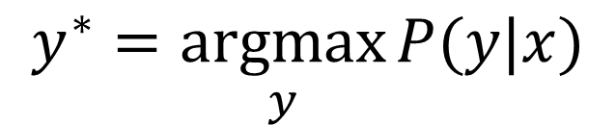
Probabilistic model
$$y^{∗}=\underset{y}{argmax}{P(y|x)}$$

Slide 7
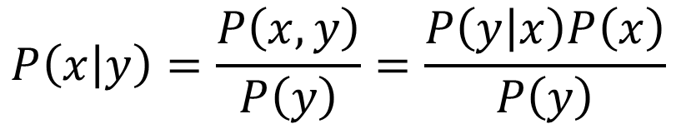
Joint and conditional probability
$$P\left(x,y\right)=P\left(x | y\right)P\left(y\right)=P\left(y | x\right)P(x)$$
$$P\left(a,b,c\right)=P\left(a | b,c\right)P\left(b | c\right)P(c)$$
$$P\left(x | y\right)=\frac{P\left(x,y\right)}{P\left(y\right)}=\frac{P\left(y | x\right)P\left(x\right)}{P\left(y\right)}$$
Bayes Rule:

Slide 8
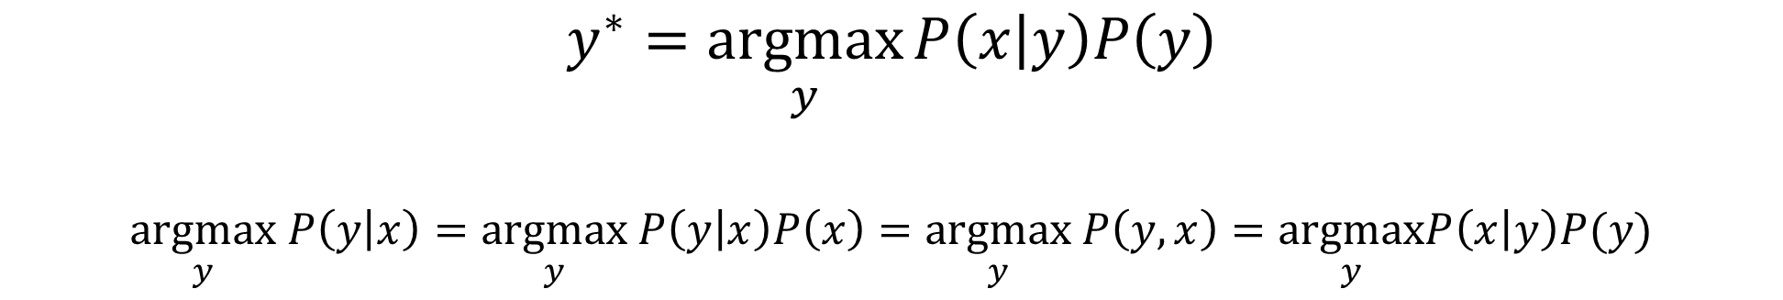
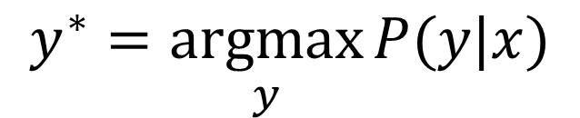
Probabilistic model
$$y^{∗}=\underset{y}{argmax}{P(y|x)}$$
Or equivalently…
$$y^{∗}=\underset{y}{argmax}{P\left(x | y\right)P\left(y\right)}$$
$$\underset{y}{argmax} P\left(y | x\right)=\underset{y}{argmax} P\left(y | x\right)P\left(x\right)=\underset{y}{argmax} P\left(y,x\right)=\underset{y}{argmax}P\left(x | y\right)P(y)$$

Slide 9

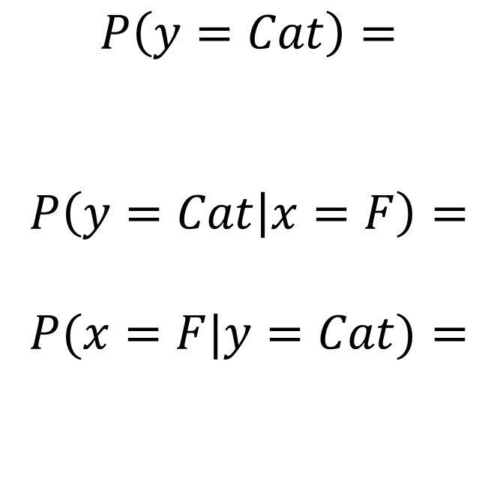

Example
$x$:
Larger than 10 lbs?
 | F | T
Cat | 15 | 25
Dog | 5 | 40
$$P\left(y=Cat\right)=$$
$$P\left(y=Cat | x=F\right)=$$
$$P(x=F|y=Cat)=$$
$$y$$

Slide 10
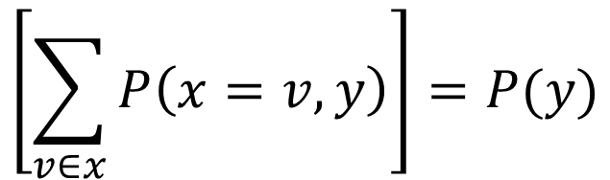
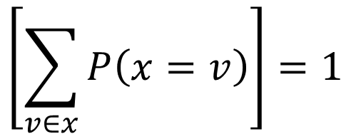
$$\left[\sum_{v∈x}{P\left(x=v\right)}\right]=1$$
Law of total probability
$$\left[\sum_{v∈x}{P\left(x=v,y\right)}\right]=P(y)$$
Marginalization
For continuous variables, replace sum over possible values with integral over domain

Slide 11
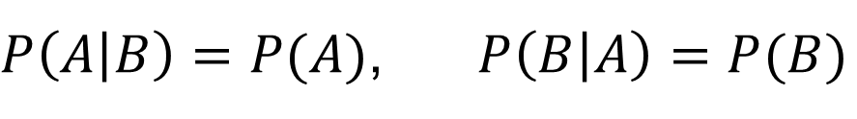

A is independent of B if (and only if)
$$P\left(A,B\right)=P\left(A\right)P\left(B\right)$$
$P\left(A | B\right)=P(A)$, $P\left(B | A\right)=P(B)$

Slide 12
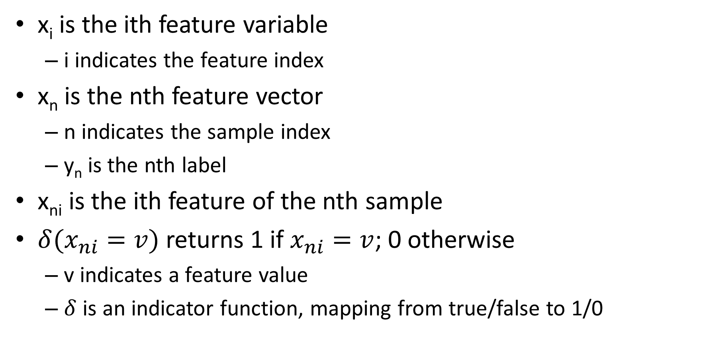
Notation
x_{i} is the ith feature variable
i indicates the feature index
x_{n} is the nth feature vector
n indicates the sample index
y_{n} is the nth label
x_{ni} is the ith feature of the nth sample
$δ(x_{ni}=v)$ returns 1 if $x_{ni}=v$; 0 otherwise
v indicates a feature value
$δ$ is an indicator function, mapping from true/false to 1/0

Slide 13
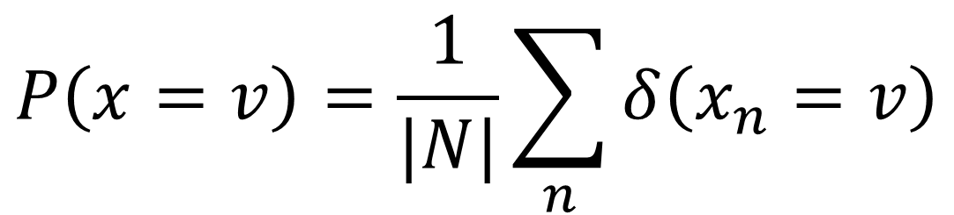
Estimate probabilities of discrete variables by counting
$$P\left(x=v\right)=\frac{1}{|N|}\sum_{n}{δ\left(x_{n}=v\right)}$$

Slide 14
What if you have 100 variables? How can you count all combinations?
Fully modeling dependencies between many variables (more than 3 or 4) is challenging and requires a lot of data

Slide 15
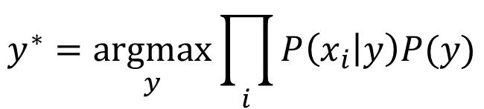

Naïve Bayes Model
Assume features x₁..x_{m} are independent given the label y:
Then
$$P\left(x | y\right)=\prod_{i}{P(x_{i}|y)}$$
$$y^{∗}=\underset{y}{argmax}{\prod_{i}{P\left(x_{i} | y\right)P(y)}}$$

Slide 16
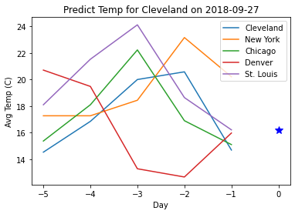
Examples
Digit classification: choose the label that maximizes the product of likelihoods of each pixel intensity
Temperature prediction: each feature predicts y with some offset and variance ( y-x_{i} is univariate Gaussian)

Slide 17

Naïve Bayes Algorithm
Training
Estimate parameters for P(x_{i}|y) for each i
Estimate parameters for P(y)
Prediction
Solve for y that maximizes P(x,y)
$$y^{∗}=\underset{y}{argmax}{\prod_{i}{P\left(x_{i} | y\right)P(y)}}$$

Slide 18
How to estimate P(x_{i}|y) from data?
Basic principles of fitting likelihood parameters from data
MLE (maximum likelihood estimation): Choose the parameter that maximizes the likelihood of the data
MAP (maximum a priori): Choose the parameter that maximizes the data likelihood and its own prior
As Warren Buffet says, it’s not just about maximizing expected return – it’s about making sure there are no zeros.

Slide 19

How to estimate P(x_{i}|y) from data?
Binomial (x is binary; y is discrete)
$$P\left(x_{i} | y=k\right)=θ_{ki}^{x_{i}}{{(1−θ}_{ki})}^{1−x_{i}}$$
Multinomial (x is has multiple discrete values, y is discrete)
theta_ki[k,i] = np.sum((X[:,i]==1) & (y==k)) / np.sum(y==k)

Slide 20
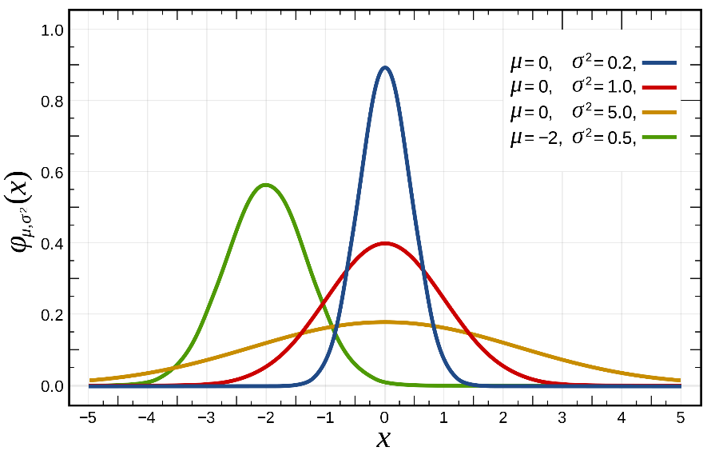
How to estimate P(x_{i}|y) from data?
x_{i} is Gaussian (aka Normal), y is discrete

Slide 21
How to estimate P(x_{i}|y) from data?
(y-x_{i}) is Gaussian
mu[i] = np.mean(y-X[:,i], axis=0)
std[i] = np.std(y-X[:,i], axis=0)

Slide 22
How to estimate P(x_{i}|y) from data?
x_{i} and y are jointly Gaussian
N(.) stands for normal distribution with given value, mean, and covariance or variance

Slide 23
How to estimate P(x_{i}|y) from data?
x_{i} is continuous (non-Gaussian), y is discrete
First turn x into discrete (e.g. if values range [0, 1), assign x=floor(x*10)
Now can estimate as multinomial

Slide 24
How to estimate P(x_{i}|y) from data?
If x is text, e.g. “blue”, “orange”, “green”
Map each possible text value into an integer and solve as multinomial

Slide 25
How to estimate P(y)?
Three options:
Assume that y is “uniform” (every value is equally likely) and ignore
If y is discrete, count
If y is continuous, model as Gaussian or convert to discrete and count

Slide 26
Stretch break: Simple Naive Bayes example
Suppose I want to classify a fruit based on description
Features: weight, color, shape, whether it’s hard
E.g.
0.5 lb, “red”, “round”, yes
15 lb, “green”, “oval”, yes
0.01 lb, “purple”, “round”, no
Q1: What are these three fruit?
Q2: How might you model P(x_{i}|fruit) for each of these four features?

Slide 27
Simple Naive Bayes example
Suppose I want to classify a fruit based on description
Features: weight, color, shape, whether it’s hard
E.g.
0.5 lb, “red”, “round”, yes
15 lb, “green”, “oval”, yes
0.01 lb, “purple”, “round”, no
Model P(weight | fruit) as a Gaussian
Model P(color | fruit) as a discrete distribution (multinomial
Model P(shape | fruit) as a multinomial
Model P(is_hard | fruit) as a Bernoulli (binary)
Apple
Watermelon
Grape

Slide 28
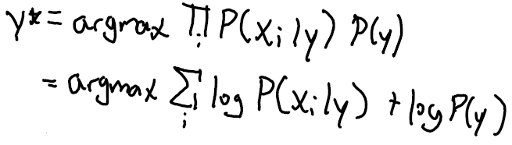
How to predict y from x?
If y is discrete:
Compute P(x,y) for each value of y
Choose value with maximum likelihood
Turning product into sum of logs is an important frequently used trick for argmax/argmin!

Slide 29
How to predict y from x?
General formulation (set partial derivative wrt y of log P(x,y) to 0)
Example: y-x_{i} is Gaussian (HW1)
Prediction is weighted average of means, where weights are inverse variance

Slide 30
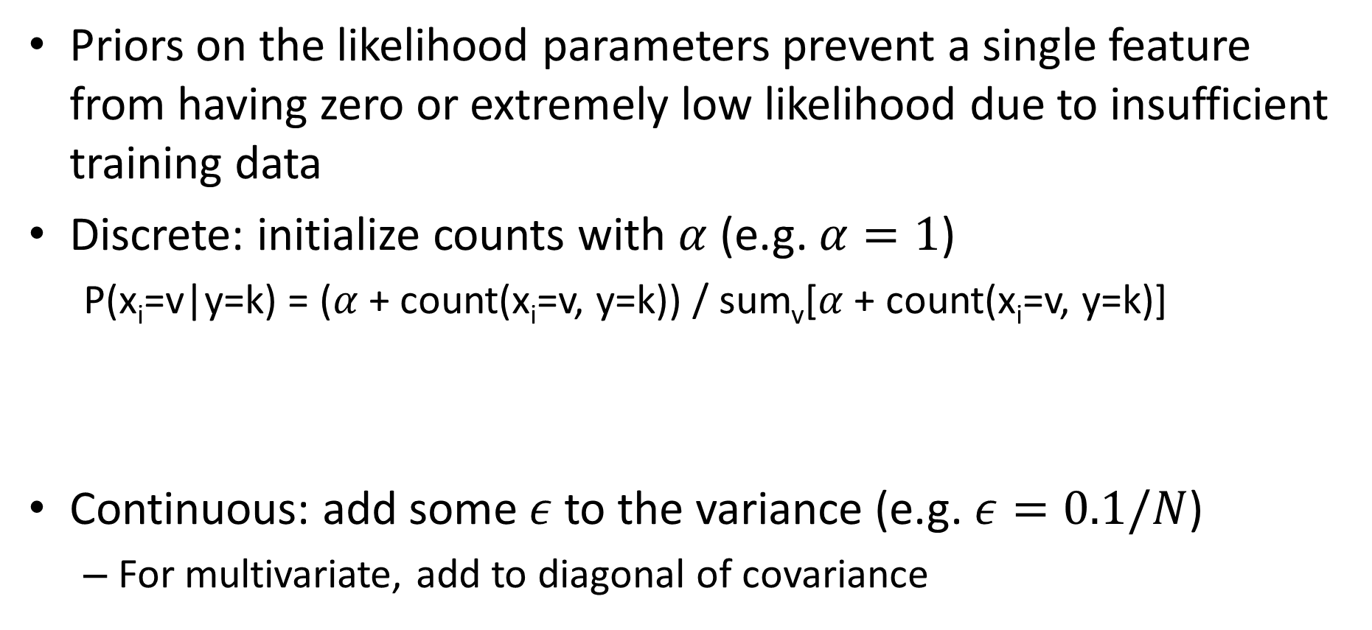
Using priors
Priors on the likelihood parameters prevent a single feature from having zero or extremely low likelihood due to insufficient training data
Discrete: initialize counts with $α$ (e.g. $α=1$)
P(x_{i}=v|y=k) = ($α$+ count(x_{i}=v, y=k)) / sum_{v}[$α$+ count(x_{i}=v, y=k)]
Continuous: add some $ε$ to the variance (e.g. $ε=0.1/N$)
For multivariate, add to diagonal of covariance
theta_kiv[k,i,v] = (np.sum((X[:,i]==v) & (y==k))+alpha) / (np.sum(y==k)+alpha*num_v)
std[i] = np.std(y-X[:,i], axis=0)+np.sqrt(0.1/len(X))

Slide 31
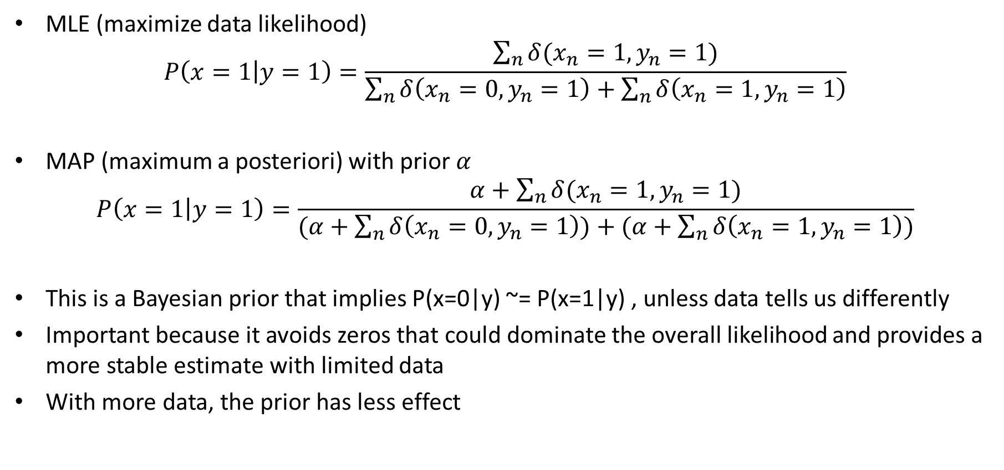
MLE and MAP estimates of discrete variable likelihoods
MLE (maximize data likelihood)
$$P\left(x=1 | y=1\right)=\frac{\sum_{n}{δ(x_{n}=1,y_{n}=1)}}{\sum_{n}{δ\left(x_{n}=0,y_{n}=1\right)+\sum_{n}{δ\left(x_{n}=1,y_{n}=1\right)}}}$$
MAP (maximum a posteriori) with prior $α$
$$P\left(x=1 | y=1\right)=\frac{α+\sum_{n}{δ(x_{n}=1,y_{n}=1)}}{(α+\sum_{n}{δ\left(x_{n}=0,y_{n}=1\right))+(α+\sum_{n}{δ\left(x_{n}=1,y_{n}=1\right)})}}$$
This is a Bayesian prior that implies P(x=0|y) ~= P(x=1|y) , unless data tells us differently
Important because it avoids zeros that could dominate the overall likelihood and provides a more stable estimate with limited data
With more data, the prior has less effect

Slide 32

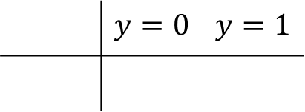
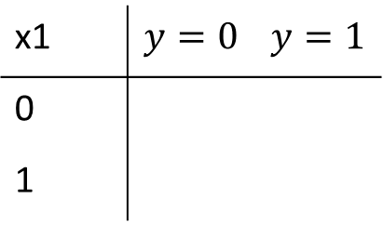


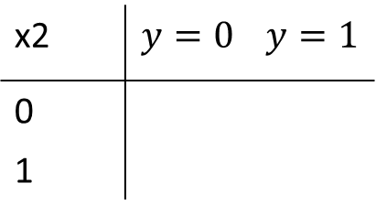
Example
x1 | $$y=0$$ | $$y=1$$
0
1
# | x1 | x2 | y
1 | 1 | 1 | 1
2 | 0 | 1 | 1
3 | 1 | 0 | 0
4 | 0 | 1 | 0
5 | 1 | 1 | 1
6 | 1 | 0 | 0
7 | 1 | 0 | 1
8 | 0 | 1 | 0
$$P(x1|y)$$
x2 | $$y=0$$ | $$y=1$$
0
1
$$P(x2|y)$$
$$P(y,x1=1,x2=1)= ?$$
 | $$y=0$$ | $$y=1$$
$$P(y)$$

Slide 33
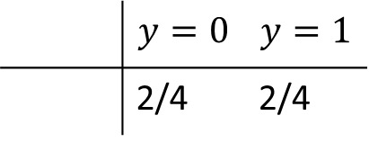
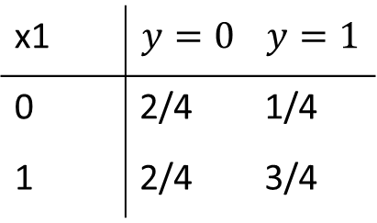
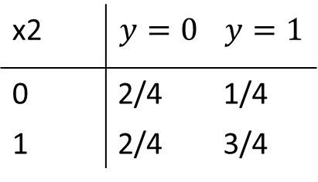
Example
x1 | $$y=0$$ | $$y=1$$
0 | 2/4 | 1/4
1 | 2/4 | 3/4
# | x1 | x2 | y
1 | 1 | 1 | 1
2 | 0 | 1 | 1
3 | 1 | 0 | 0
4 | 0 | 1 | 0
5 | 1 | 1 | 1
6 | 1 | 0 | 0
7 | 1 | 0 | 1
8 | 0 | 1 | 0
$$P(x1|y)$$
x2 | $$y=0$$ | $$y=1$$
0 | 2/4 | 1/4
1 | 2/4 | 3/4
$$P(x2|y)$$
$$P(y,x1=1,x2=1)= ?$$
 | $$y=0$$ | $$y=1$$
 | 2/4 | 2/4
$$P(y)$$

Slide 34
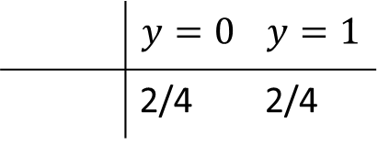
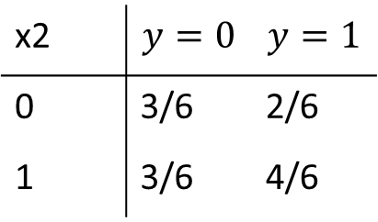
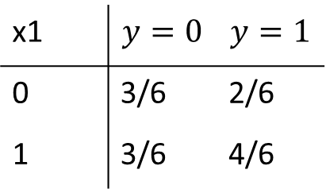
Prior over parameters: initialize each count with $α$
$$α=1$$
x1 | $$y=0$$ | $$y=1$$
0 | 2/4 | 1/4
1 | 2/4 | 3/4
x1 | $$y=0$$ | $$y=1$$
0 | 3/6 | 2/6
1 | 3/6 | 4/6
# | x1 | x2 | y
1 | 1 | 1 | 1
2 | 0 | 1 | 1
3 | 1 | 0 | 0
4 | 0 | 1 | 0
5 | 1 | 1 | 1
6 | 1 | 0 | 0
7 | 1 | 0 | 1
8 | 0 | 1 | 0
$$P(x1|y)$$
x2 | $$y=0$$ | $$y=1$$
0 | 2/4 | 1/4
1 | 2/4 | 3/4
x2 | $$y=0$$ | $$y=1$$
0 | 3/6 | 2/6
1 | 3/6 | 4/6
$$P(x2|y)$$
 | $$y=0$$ | $$y=1$$
 | 2/4 | 2/4
 | $$y=0$$ | $$y=1$$
 | 2/4 | 2/4
$$P(y)$$

Slide 35
Use case: “Semi-naïve Bayes” object detection
Best performing face/car detector in 2000-2005
Model probabilities of small groups of features (wavelet coefficients)
Search for groupings, discretize features, estimate parameters
https://www.cs.cmu.edu/afs/cs.cmu.edu/user/hws/www/CVPR00.pdf

Slide 36
Naïve Bayes Summary
Key Assumptions
Features are independent, given the labels
Model Parameters
Parameters of probability functions P(x_{i}|y) and P(y)
Designs
Choice of probability function
When to Use
Limited training data
Features are not highly interdependent
Want something fast to code, train, and test
When Not to Use
Logistic or linear regression will usually work better if there is sufficient data (more flexible / fewer assumptions than Naïve Bayes)
Does not provide a good confidence estimate because it “overcounts” influence of dependent variables

Slide 37
Naïve Bayes
Pros
Easy and fast to train
Fast inference
Can be used with continuous, discrete, or mixed features
Cons
Does not account for feature interactions
Does not provide good confidence estimate
Notes
Best when used with discrete variables, variables that are well fit by Gaussian, or kernel density estimation

Slide 38
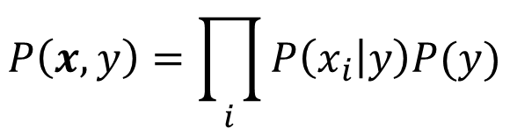
Things to remember
Probabilistic models are a large class of machine learning methods
Naïve Bayes assumes that features are independent given the label
Easy/fast to estimate parameters
Less risk of overfitting when data is limited
You can look up how to estimate parameters for most common probability models
Or take partial derivative of total data/label likelihood given parameter
Prediction involves finding y that maximizes P(x,y), either by trying all y or solving partial derivative
Maximizing log P(x,y) is equivalent to maximizing P(x,y) and often much easier
$$P\left(x,y\right)=\prod_{i}{P\left(x_{i} | y\right)P(y)}$$

Slide 39
Next class
Logistic Regression and Linear Regression

